Slide 1
Estimating Global Inventory-Based Net Carbon Exchange from Agricultural Lands for Use in the NASA Flux Pilot Study
Julie Wolf, Yannick Le Page and Tris West
Joint Global Change Research Institute
CMS 2014 Science Team Meeting
Notes:
2012 project

Slide 2
Objectives:
Quantify global agricultural carbon fluxes:
Notes:
carbon is fixed by crop plants and a lot of that decomposes in place to return to the atmosphere as CO2. here we track those carbon fluxes, as well as the transport and consumption of carbon in harvested material. we also estimate how much carbon is brought into the agricultural system from non-crop lands by livestock foraging, i.e. grazing

Slide 3
Objectives:
Quantify global agricultural carbon fluxes:
    Above- and belowground crop biomass
    Harvested and removed crop biomass
    Crop residues left on field
    Crop net primary productivity (NPP)
    Livestock intake of crop harvests and crop residues
    Livestock forage/grazing of non-crop carbon
    Human intake of crop- and livestock-based food
Notes:
livestock intake of crop products is referred to as FODDER. livestock grazing and scavenging is referred to as FORAGE.

Slide 4
Objectives:
Quantify global agricultural carbon fluxes
Quantify agricultural net carbon exchange
(NCE) and construct carbon budget
Distribute carbon fluxes at 0.05 degree scale for 2005 - 2011
Estimate uncertainty for all carbon fluxes
Notes:
once we have quantified all of these carbon fluxes, we can quantify net carbon exchange over agricultural, livestock, and human-inhabited areas and construct a carbon budget. uncertainty will be estimated along the way by assembling uncertainty ranges on all the quantities that go into our calculations.

Slide 5
Methods:
Combine
  Inventory data for crops, livestock, and human populations (1961 – 2011)
  Carbon coefficients
  Satellite-based land cover (2005 base year)
to create spatially resolved estimates of NCE
Notes:
we have a poster up and i can tell you about methods in GREAT DETAIL later, if anyone is interested. (but don’t let me go on and on!). in brief, we use inventory data. What is time frame—2000s for distr., coefficients, overall data).

Slide 6
Methods:
NCE = -NPP + belowground biomass + residue + food intake + fodder intake
(ignoring changes in soil carbon, eq. simplifies to)
↓
NCE = -harvest + food intake + fodder intake
Notes:
NCE is the carbon balance for agricultural NPP in each region, country, or gridcell. because we assume that residue and belowground crop biomass decompose within 1 year, the math for NCE simplifies to the balance of harvest and harvest removed for consumption elsewhere. of course this is a simplification; our next project will address the aspects that we ignore here.

Slide 7
Methods:
Spatial distribution:
Crops – MODIS 500m landcover product (2005), cropland area reconciled to match reported harvested areas.
Livestock – estimated area requirements for housed and free-ranging populations placed on grassland and shrubland; also on croplands in dense areas
Humans – SEDAC 2005 Gridded Human Population of the World.
Notes:
NCE is the carbon balance for agricultural NPP in each region, country, or gridcell. because we assume that residue and belowground crop biomass decompose within 1 year, the math for NCE simplifies to the balance of harvest and harvest removed for consumption elsewhere. of course this is a simplification; our next project will address the aspects that we ignore here.

Slide 8
Methods:
Uncertainty:
Develop probability density functions for all coefficients, based on range in published values.
Monte Carlo Analysis of complete mathematical model for each flux quantity.
Notes:
NCE is the carbon balance for agricultural NPP in each region, country, or gridcell. because we assume that residue and belowground crop biomass decompose within 1 year, the math for NCE simplifies to the balance of harvest and harvest removed for consumption elsewhere. of course this is a simplification; our next project will address the aspects that we ignore here.

Slide 9
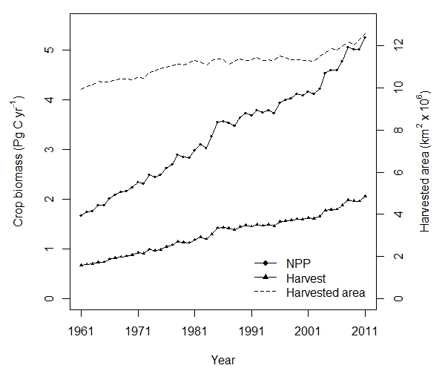
Results:
Crop harvest, NPP, and area
Notes:
we track crop NPP, harvest, and harvested area over 51 years. crop and yield improvements are evidenced by the different trajectories.

Slide 10
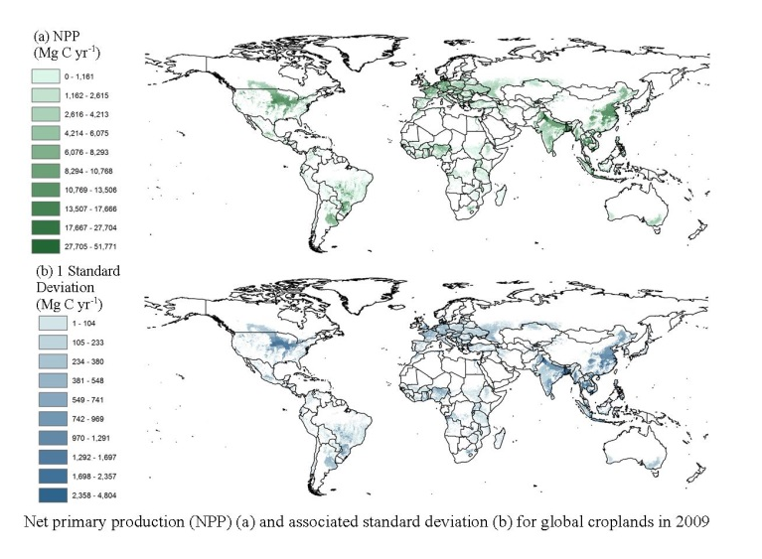
Results:
Crop NPP spatial distribution
Notes:
NPP and uncertainty at the 0.05 degree scale, darker colors larger quantities

Slide 11
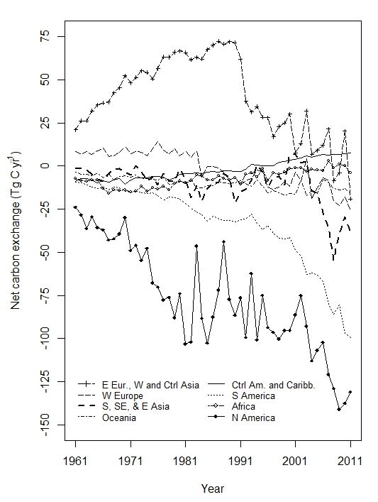
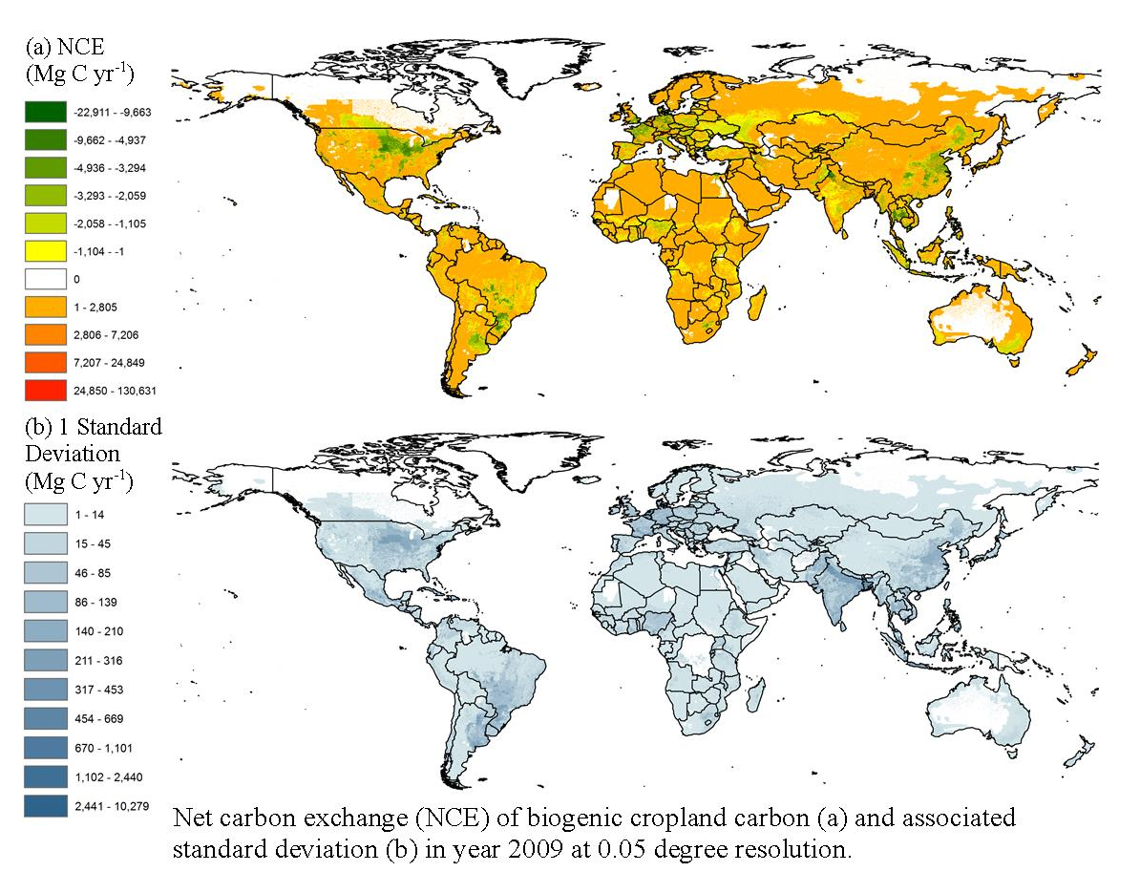
Results:
Regional NCE and spatial distribution
(NCE = -harvest + food intake + fodder intake)
Notes:
NCE is negative in most regions and years, because not all of crop harvest is consumed within each region as food and fodder. a noticeable exception is Russia and the middle east, where very large portions of both food and fodder are imported, resulting in positive regional values. more negative values found in nations where large quantities of harvest are exported for consumption elsewhere (e.g. N and S America)

Slide 12
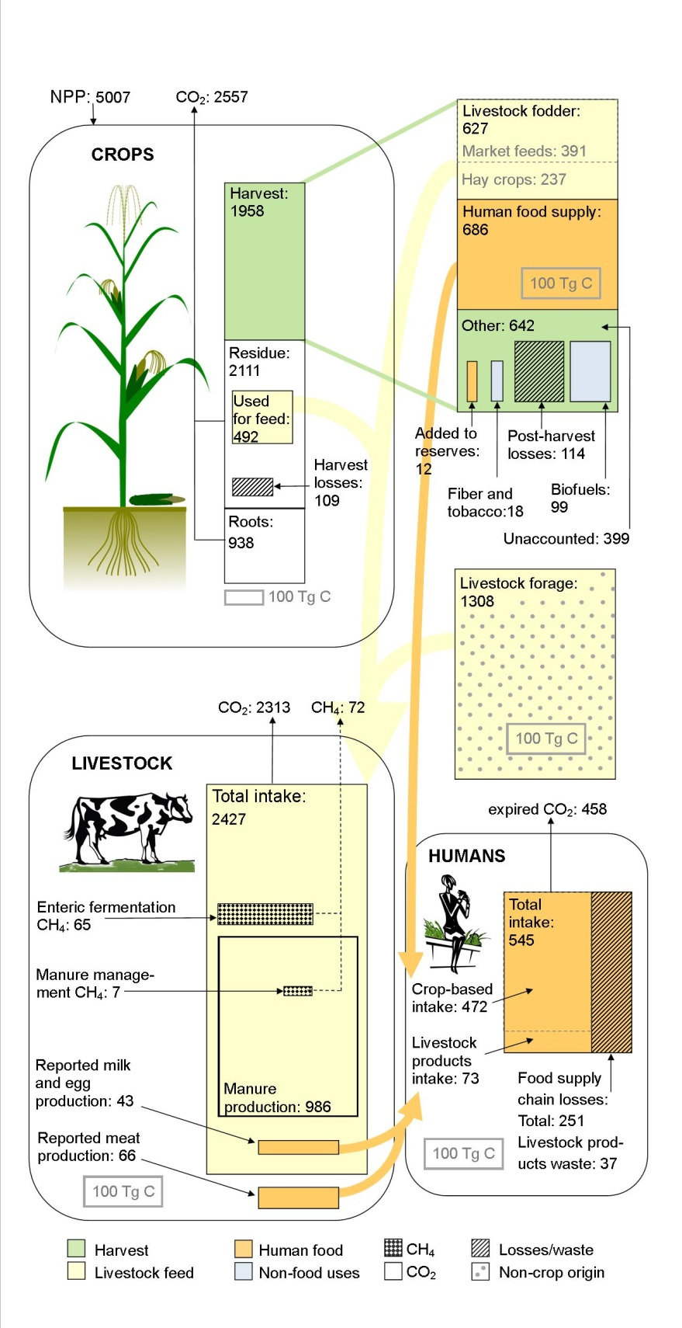
Results:
Global agricultural budget
Notes:
We have constructed detailed budgets for 2005 and 2009, 2009 shown here

Slide 13
Results:
Global agricultural budget
agricultural losses
post-harvest losses
food supply chain losses/waste
Notes:
We have constructed detailed budgets for 2005 and 2009; please come see my poster if you would like more time to see them.

Slide 14
Results:
Global agricultural budget
Detailed livestock intake:
  crop residues
  primary harvest
  hay and fodder crops
  forage/grazing
Notes:
We have constructed detailed budgets for 2005 and 2009; please come see my poster if you would like more time to see them.

Slide 15
Conclusions:
Objectives completed
Manuscript completed: “Biogenic carbon fluxes from global agricultural production and consumption”
Data available include spatial distributions, coefficients developed, crop residue, livestock feed sources, and livestock manure production.
Notes:
data will be archived, possibly at ORNL CDIAC or DAAC.

Slide 16
Thank you.

